Slide 1

Introduction to Github and Python
Learning Session #1
June 20, 2018

Slide 2
Table of Contents
1. Syllabus
2. GitHub
3. Python

Slide 3
Syllabus
Notes:
This brings the session to an end. Before we let you go, we will go through some next steps.

Slide 4
Find your syllabus in MS Team and/or Github!

Slide 5

GitHub
Notes:
This brings the session to an end. Before we let you go, we will go through some next steps.

Slide 6
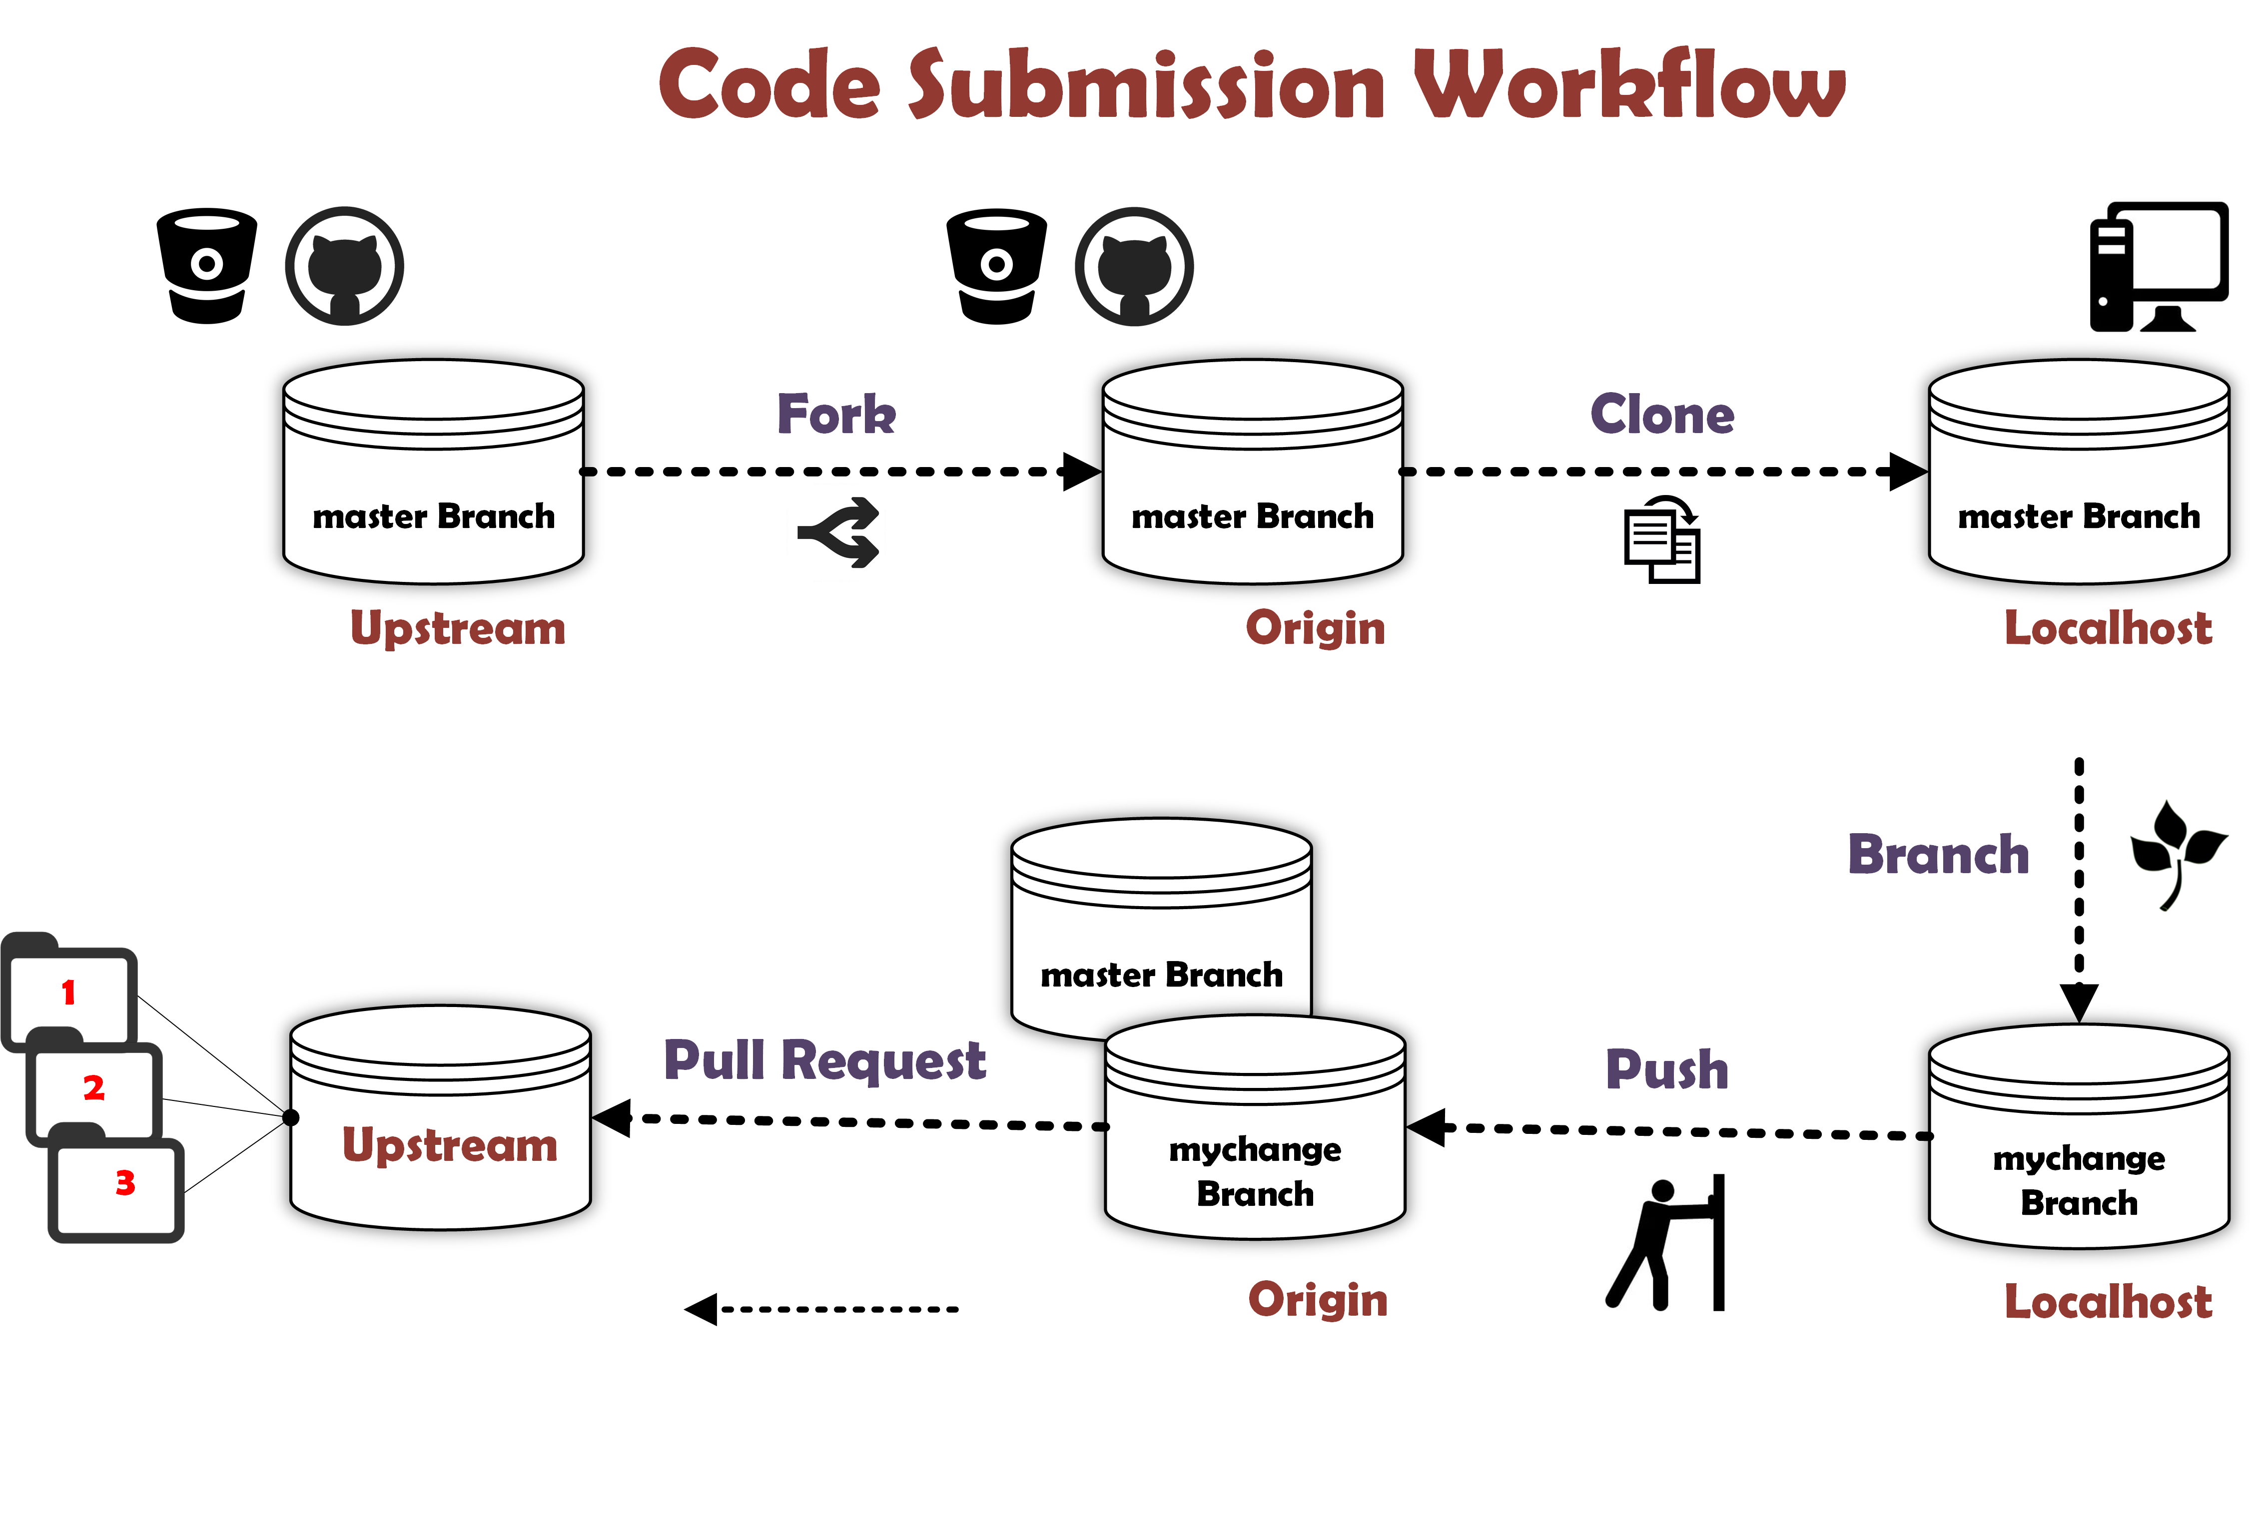
Code Submission Workflow
radhika/project01
ray/project01
ray/project01
radhika/project01
ray/project01
ray/project01

Slide 7
Steps
Step | Description | Where | Code
Fork | Create a copy in my own repository | Remote
Git clone | Add a new file on my local | Remote -> Local | git clone
Git status | Check the status of files | Local | git status
Add | Add to the list to be pushed | Local | git add
Commit | Make the commit and comments | Local | git commit –m “……”
push | Push the change to my own repository | Local -> Remote | git push
Pull request | Contribute back to the original (“upstream”) | Remote

Slide 8
DEMO
Notes:
This brings the session to an end. Before we let you go, we will go through some next steps.

Slide 9
Python
Notes:
This brings the session to an end. Before we let you go, we will go through some next steps.

Slide 10
Learning Resources
Resource | Notes | Cost | Link
Code Academy | Have an introductory course | Free | https://www.codecademy.com/learn/learn-python
Data Camp | Have an introductory course | Free | https://www.datacamp.com/courses/intro-to-python-for-data-science
Coursera | Online catalogue of courses that are partnered with different universities and schools | Some free and paid courses | https://www.coursera.org/courses?languages=en&query=python
Udemy | Online catalogue of courses | Free and $15 courses | https://www.udemy.com/complete-python-bootcamp/
YouTube | For tutorials | Free
StackOverflow | Good to use when trying to solve a specific problem | Free
Resource | Notes | Cost | Link
Deloitte Python Course | Have an introductory course | Free | https://sabacloud.deloitteresources.com/Saba/Web_spf/E103PRD0001/local

Slide 11
Basics
Function | Description | Code
Print | Function used to print to screen | print("Hello world!")
Indentation | Indentation is used to indicate a block of code. Python will not able to recognize the code if there is no indentation. | if 5 > 2: print("5 is greater than 2")
Commenting | Hash-tag used for in-code documentation. Important to include comments so that other users can understand your code. | #Comment print("Hello world!")
Docstrings | Triple quotes used for extended documentation. | """multi-line comments""" print("Hello world!")

Slide 12
Variables
There is no command to declare a variable. A variable is created when a value is assigned to it.
x = "Hello"
y = 5
print(x)
print(y)
Variables can be changed after they have been set.
x = 4
print(x)
x = "hi"
print(x)
A variable must start with a letter or underscore
A variable cannot start with a number
A variable can only contain alpha-numeric characters and underscores (A-z, 0-9, and _ )
Variable names are case-sensitive (age, Age and AGE are three different variables)

Slide 13
Numbers
Function | Description | Example
Integer | Int, or integer, is a whole number, positive or negative, without decimals, of unlimited length. | x = 1 y = 356562225548877 z = -3255522
Float | Float, or "floating point number" is a number, positive or negative, containing one or more decimals. | x = 1.10 y = 1.0 z = -35.59
Complex | Complex numbers are written with a "j" as the imaginary part: | x = 3+5j y = 5j z = -5j
To verify the type of object, the type() function can be used.
test_var = 5.38 print(type(test_var))

Slide 14
Strings
String literals in python are surrounded by either single quotation marks (‘string’), or double quotation marks (“string”).
Function | Description | Code
Strip strip() | Removes whitespaces from the beginning and/or end | a = " How are you? " print(a.strip())
Length len() | Returns length of a string | print(len(a))
Lower lower() | Returns the string in lower case | print(a.lower())
Upper upper() | Returns the string in upper case | print(a.upper())
Replace replace() | Replaces a string with another string | print(a.replace("o", "l"))

Slide 15
Operators
Below are some common operators that can be used to perform operations on variables and / or values.
Operator | Name | Example
+ | Addition | x + y
- | Subtraction | x - y
* | Multiplication | x * y
/ | Division | x / y
% | Modulus | x % y
** | Exponentiation | x ** y
// | Floor division | x // y
Notes:
Floor division = integer division
5//2 will return 2 while 5/2 returns 2.5

Slide 16
Lists
Lists are a collection which is ordered and changeable. Lists are written in square brackets.
example_list = ["apple", "banana", "orange"]
Function | Description | Code
Index | To specify order, use index. The first object/letter has an index of 0. | example_list[1] = "grapes" print(example_list)
Append | To add an item to the list | example_list.append("watermelon") print(example_list)
Remove | To remove an item from the list | example_list.remove("apple") print(example_list)
Length | To determine length (number of items) in the list | print(len(example_list))

Slide 17
Dictionaries
A dictionary is a collection which is unordered, changeable and indexed. In Python dictionaries are written with curly brackets, and they have keys and values.
To update a value: example_dict["apple"] = "green"
example_dict = {"key":"value"}
example_dict = {"apple":"red", "banana":"yellow", "cherry":"red"}

Slide 18
Conditions
Condition | Condition Statement
Equals | a==b
Not equals | a!=b
Less than | a < b
Less than or equal to | a <= b
Greater than | a > b
Greater than or equal to | a > = b

Slide 19
If Statement
“If statements” in Python use the “if” keyword. If statement end with “:”. Statements on the following lines must follow Python indentation rules to be recognized.
a = 5
b = 230
The following code will result in an error:
if b > a :
print("B is greater than A")
The following code will work as intended:
if b > a :
print("B is greater than A")

Slide 20
Elif and Else
“Elif” is a way of saying “if the previous condition was not true, then do this condition”. “Else” catches anything not caught by preceding conditions.
a = 5
b = 230
if b > a :
print(“b is greater than a")
elif a == b:
print(“a and b are equal”)
else:
print(“a is greater than b”)

Slide 21
Conditionals Exercise
For the code below, write what you think the result would be given the location and pay listed below. Check your answer after by running the code.
location = (to update)
pay = (to update)
if location == "Vancouver":
print("So long, suckers! I’ll take it!")
elif location == "Ottawa":
if pay < 100000:
print("No way")
else:
print("I’ll take it!")
elif location == "California" and pay > 40000:
print("I’ll take it!")
elif pay > 60000:
print("I’ll take it!")
else:
print("No thanks, I can find something better.")
location = "Ottawa" pay = 50000
location = "Mississauga" pay = 50000
location = "California" pay = 50000
location = "Vancouver" pay = 1
location = "California" pay = 25000
Notes:
UPDATED

Slide 22
While Loop
While loop can execute statements as long as a condition is true.
Print ‘i’ as long as ‘i’ is less than 8:
i = 0
while i < 8:
i+=1
print(i)
A break statement can be used to stop the loop even while the condition is true.
To exit the loop when i = 5:
i = 0
while i < 8:
i+=1
print(i)
if i == 5:
break

Slide 23
For Loop
A for loop is used to iterate over a sequence (e.g. list).
fruits = ["apple", "banana", "cherry"]
for x in fruits:
print(x)
A break statement can be used to stop the loop.
To exit the loop when the list value is “banana”:
fruits = ["apple", "banana", "cherry"]
for x in fruits:
if x == "banana":
break
print(x)
The continue statement can be used to stop the current iteration of the loop and continue with the next.
To not print the list value of “banana”:
fruits = ["apple", "banana", "cherry"]
for x in fruits:
if x == "banana":
continue
print(x)

Slide 24
Loops Exercises
For each of the following fragments of code, write what you think the output would be. Do this without running the code. Feel free to run the code after to check your answer.
Exercise 1:
num = 10
while num > 3:
num = num - 1
print(num)
Exercise 2:
num = 10
while True:
num -= 1
if num < 7:
break
print(num)
Exercise 3:
count = 0
for letter in "Snow!":
count += 1
print("Letter #", count, "is", letter)

Slide 25
Functions
A function is a block of code which only runs when called.
def my_function():
print("Hello")
my_function()
Information can be passed to functions as a parameter. Parameters are specified after the function name inside the parenthesis.
def my_function(country):
print("I live in: " + country)
my_function("Canada")
my_function("USA")
my_function("Norway")
Functions can return a value using the “return” statement.
def my_function(x):
return 5 * x
print(my_function(-4))
print(my_function(7))
print(my_function(6))

Slide 26
Libraries
Python has built in libraries with a set of functions that users can call on. Some libraries include:
Library | Purpose
Pandas | Data manipulation and analysis
xlrd | Extract data from Excel
NumPy | Advanced math functionalities
The ‘import’ function can be used to call on a library.
import pandas
import xlrd
import numpy

